Slide 1
Sprints JIRA

Slide 2

Agile Methodology
Software development method used to rapidly develop software. The agile manifesto was written in 2001. The manifesto contains 4 values and 12 principles
Individuals and interactions over processes and tools
Working software over comprehensive documentation
Customer collaboration over contract negotiation
Responding to change over following a plan
Source: Manifesto for Agile Software Development (agilemanifesto.org)

Slide 3
Agile 12 Principles
Our highest priority is to satisfy the customer through early and continuous delivery of valuable software.
Welcome changing requirements, even late in development. Agile processes harness change for the customer's competitive advantage.
Deliver working software frequently, from a couple of weeks to a couple of months, with a preference to the shorter timescale.
Business people and developers must work together daily throughout the project.
Build projects around motivated individuals. Give them the environment and support they need, and trust them to get the job done.
The most efficient and effective method of conveying information to and within a development team is face-to-face conversation.
Working software is the primary measure of progress.
Agile processes promote sustainable development. The sponsors, developers, and users should be able to maintain a constant pace indefinitely.
Continuous attention to technical excellence and good design enhances agility.
Simplicity--the art of maximizing the amount of work not done--is essential.
The best architectures, requirements, and designs emerge from self-organizing teams.
At regular intervals, the team reflects on how to become more effective, then tunes and adjusts its behavior accordingly.
Source: Manifesto for Agile Software Development (agilemanifesto.org)

Slide 4
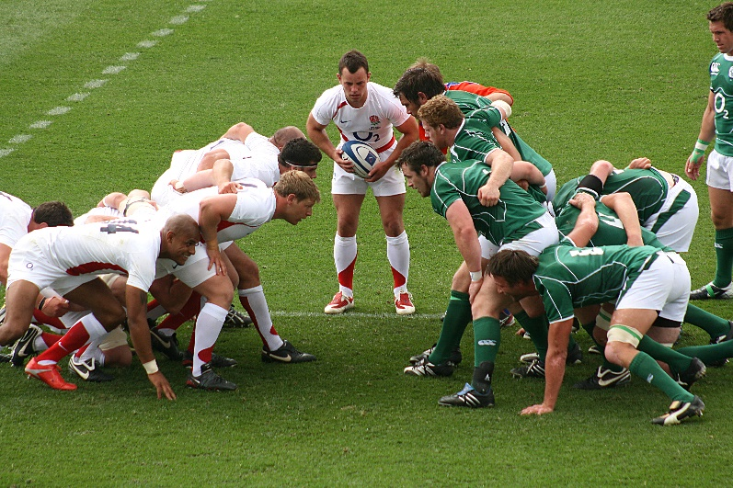
Scrum
Scrum is an iterative process to software development. A way to control risk utilizing a group of individuals who have all the skills and expertise required or acquire and share the skills as needed.
Scrum is an iterative process to software development. A way to control risk utilizing a group of individuals who have all the skills and expertise required or acquire and share the skills as needed.
Scrum Values
Commitment
Focus
Openness
Courage
Source: Home | Scrum Guides

Slide 5
Agile –Scrum Vs Traditional
Deploy at the end of every sprint
Test at the end of every sprint

Slide 6
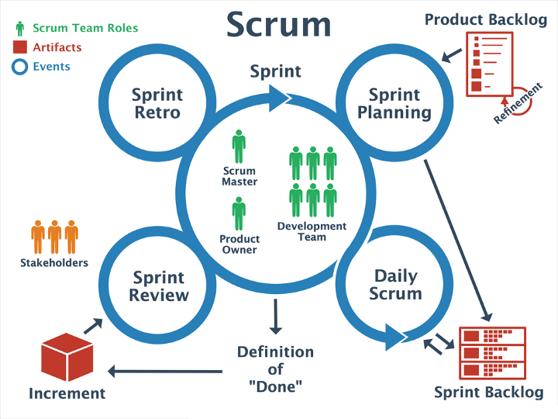
Agile – Scrum Components
Product Roadmap
Project blueprint
All the requirements written as backlog items
Epics
Features to big to be completed in a single sprint (Your Projects)
Big “Story”
Example: Dog park app
Story
Features within the epic
Example: login page
Tasks
Elements of the “Story”
Example: Program hashing algorithm for password entry
Example: Queue database for username entry
Example: Change image of login icon

Slide 7

Agile-Scrum
Agile-Scrum is broken down into several components to keep your sprints organized.
Epic
Large bodies of work
Example – Build Dog Park Application
Epics are divided into stories
Stories
Also known as “user stories”
Shorter tasks within an epic
Example – Develop Login page for dog park app
Stories are divided into Tasks
Tasks
Detailed components of a story
Specific functions within the code itself
Example – Create hashing algorithm for passwords
Source: https://www.atlassian.com/agile/project-management/epics-stories-themes
Source: https://community.atlassian.com/t5/Jira-articles/Understanding-issue-types-in-jira/ba-p/1497237

Slide 8
Agile Methodology
Stories are broken into several tasks
Sprint Process, Develop all Stories and sub tasks then test and deploy

Slide 9
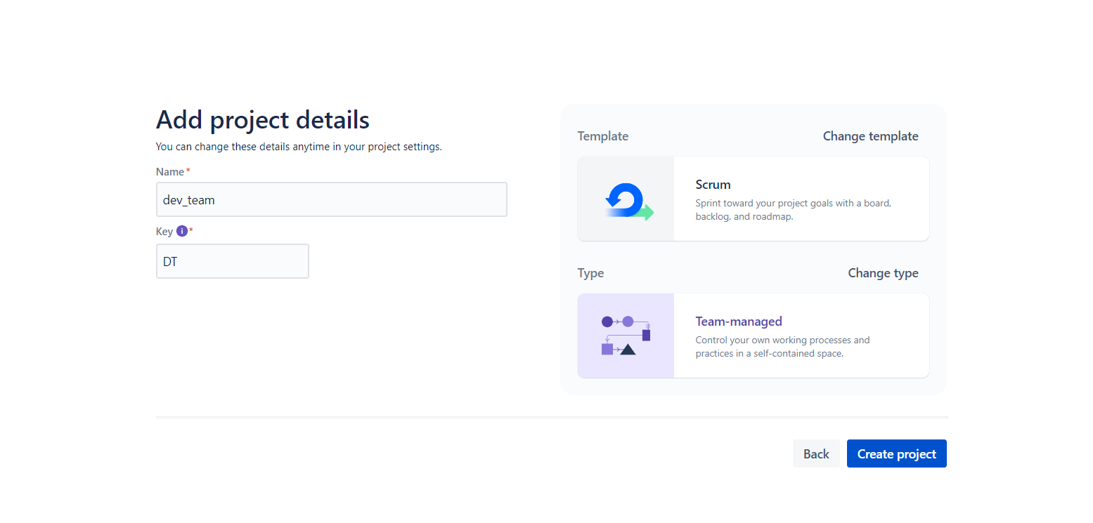
JIRA
Project creation screen
Notice the DT key – this will be what is used to prefix the project tasks
The Key will be used for tracking in JIRA and GIT
Scrum Template
We use agile-scrum methodology in this course
Source: https://id.atlassian.com/

Slide 10
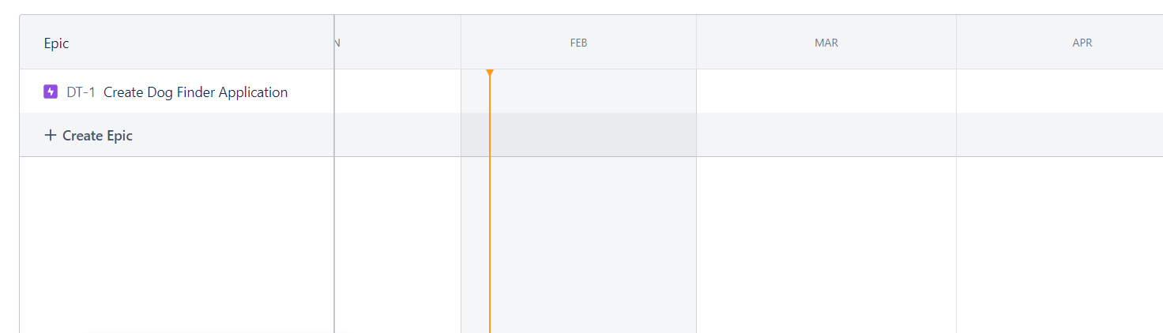
JIRA
Your First task is to create an Epic
Must of your projects will only have 1 epic
We do not have enough time in this course to span multiple epics
Notice the Key prefix DT
The Prefix number auto increments
Name the epic appropriate to the context

Slide 11
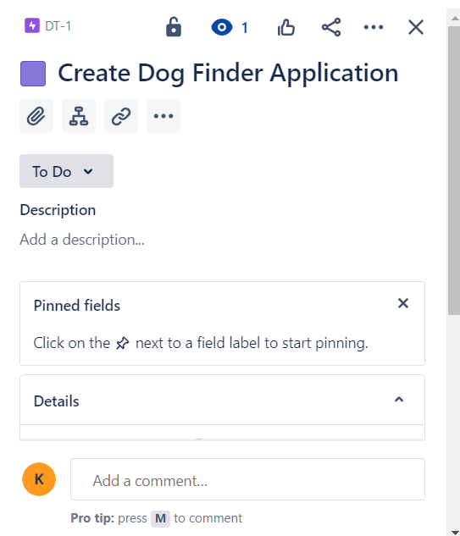
JIRA
Epic Settings
Double click on the epic to see the settings screen
Child Items
Add child items
Child items will be the stories your team has come up with

Slide 12
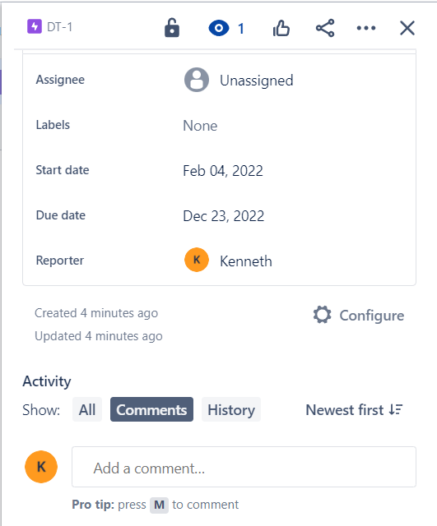
JIRA
Epic Settings
Set the date range for the epic
The start is the very beginning
The first sprint is the start
The end is the end of CSC 190
Reporter
This is the person who organizes the sprints and schedules tasks to be completed
Normally Team leader but can be an assigned position
The Reporter should be detailed orientated
Its Important to note that the reporter role is an extra duty and the reporter will still be expected to contribute to the code base and show regular git commits. Being the reporter is not a substitute for code development

Slide 13
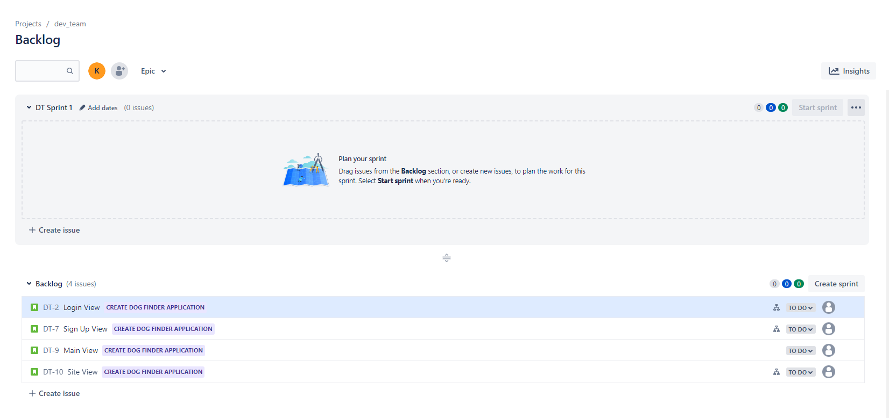
JIRA
After all the stories are added as child dependencies you will see them in the backlog tab of JIRA
Source: https://id.atlassian.com/

Slide 14
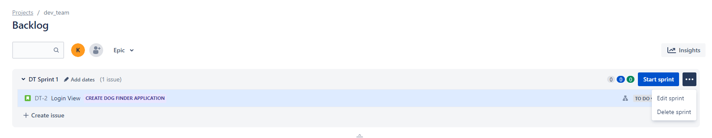
JIRA
In the backlog screen you can create sprints
Each sprint can have multiple stories to complete
Ensure that the amount of stories added to a sprint can be realistically completed
Completion of a sprint means meeting the definition of done
Done is defined as -- all tasks completed, tested and delivered (Think CI)
Clicking on the 3 dots in the right corner allows you to edit the sprint timeline
A sprint is 2 weeks

Slide 15
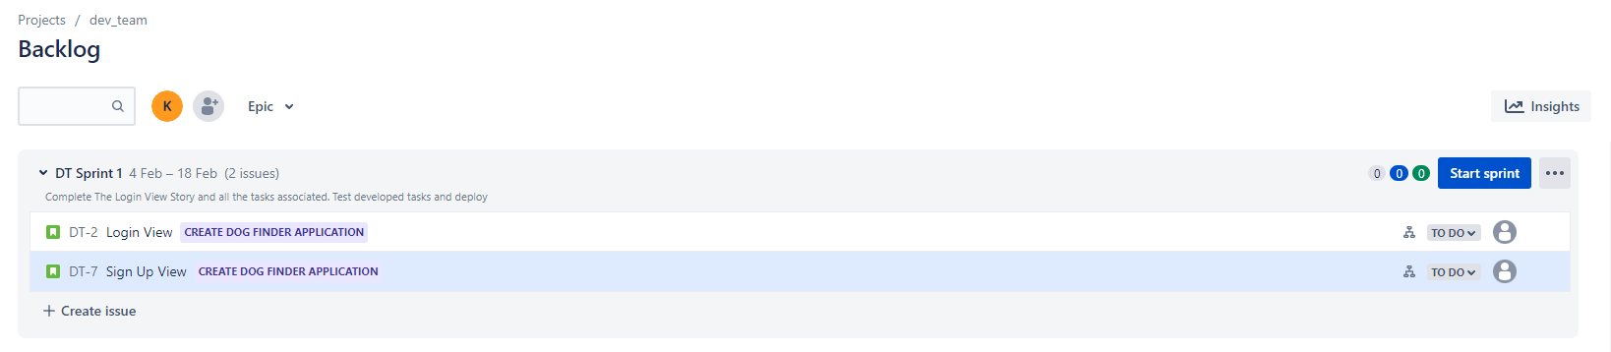
JIRA
This is an example of multiple stories in one sprint
Drag and drop each story into the sprint during the sprint planning phase.

Slide 16
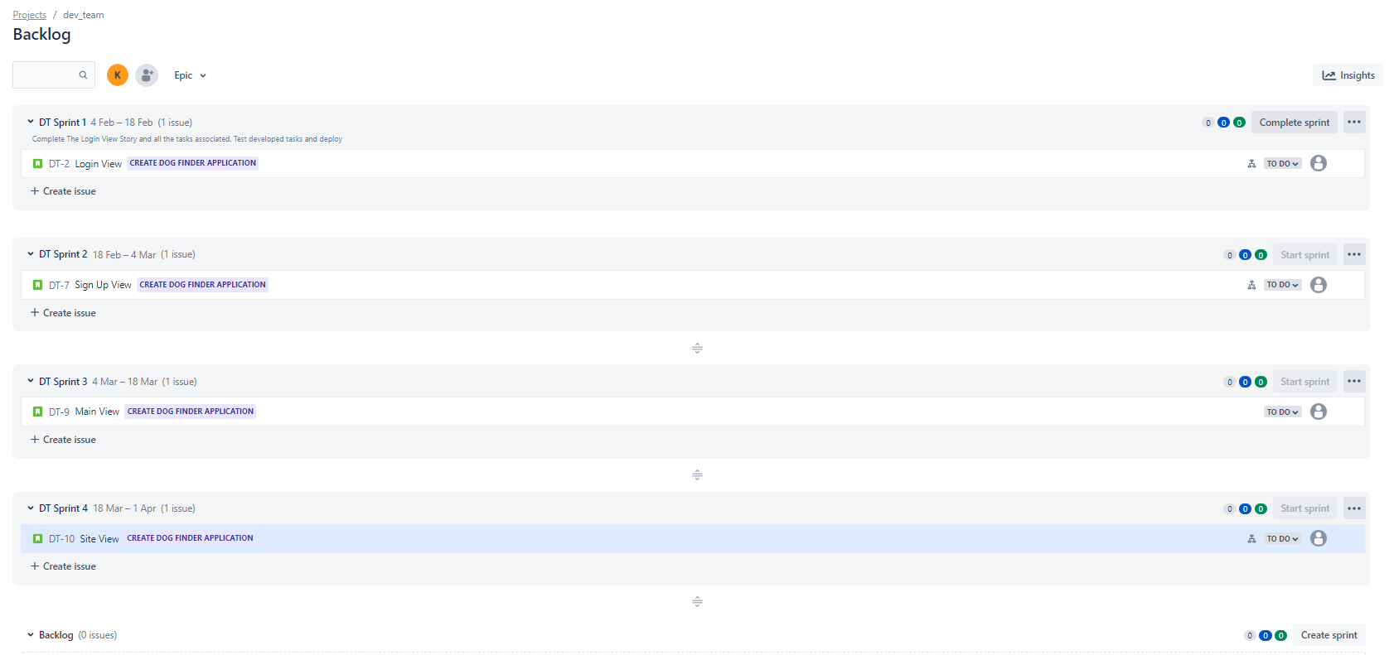
JIRA
Plan all the sprints
The sprints can be changed during each sprint planning meeting (Agile)
Sometime backlog items will slip pushing a story into the next sprint

Slide 17
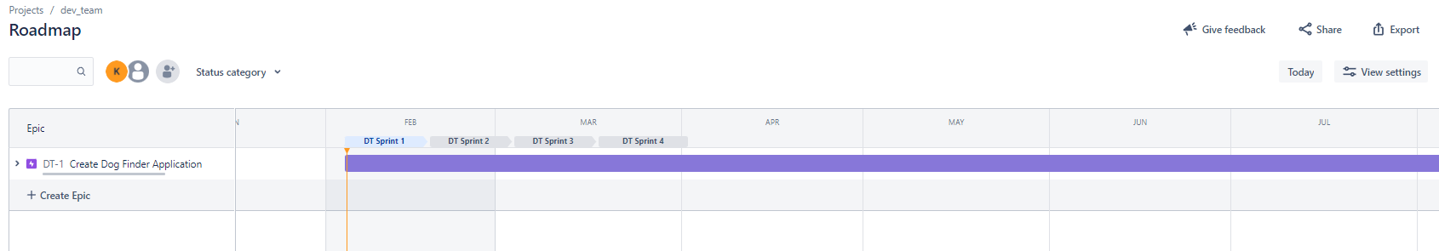
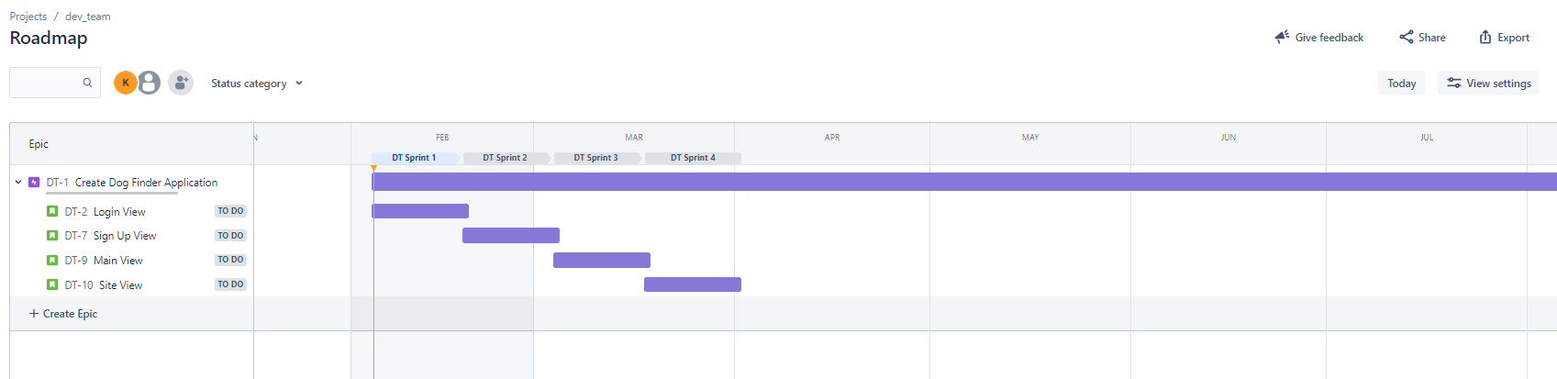
JIRA
Click on the Road map tab
The road map tab will show the timeline and the tasks to complete
Click the drop down to see the sprints
It is important to track your progress and ensure your on track to finish the project on time

Slide 18
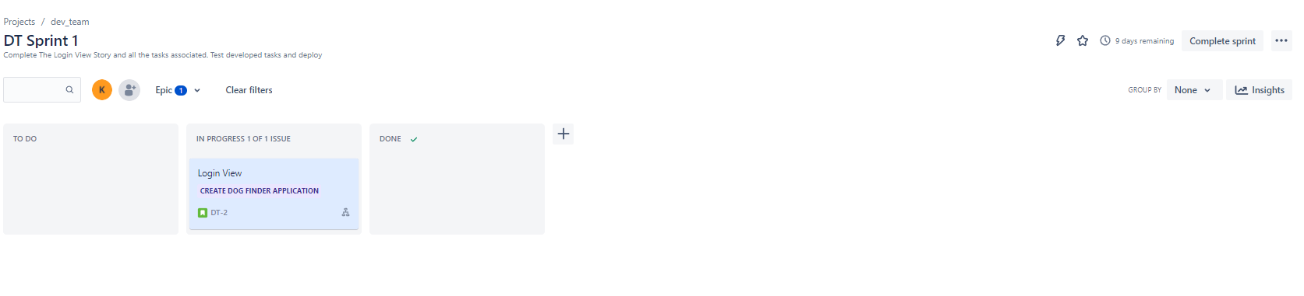
JIRA
Sprint Tab
Move stories into the to do section
When they are complete move them to the done section of the sprint
Done stories have had ALL their tasks completed, tested, peer reviewed and loaded into git
Completed sprint
Completed sprint button is clicked when the clock runs out regardless of if the tasks are completed (Task Slip)

Slide 19
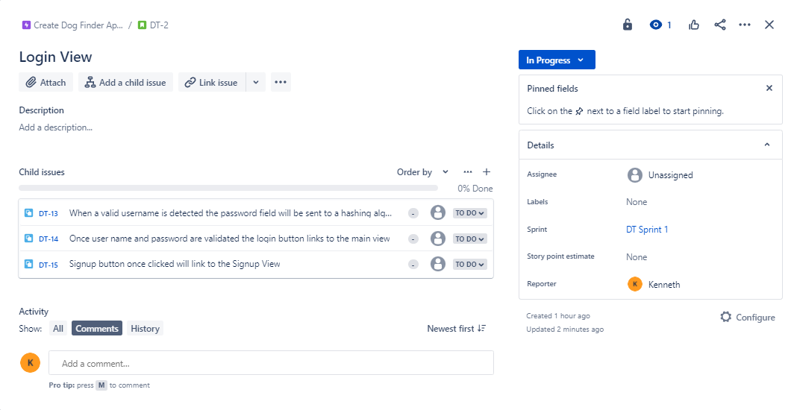
JIRA
Clicking on the story within the sprint page will show the sub tasks
Assign each sub task to a developer
Assign tasks evenly based off difficulty and quantity
Every team member should be assigned tasks
Task Numbers
Task numbers should be referenced in the git commits

Slide 20
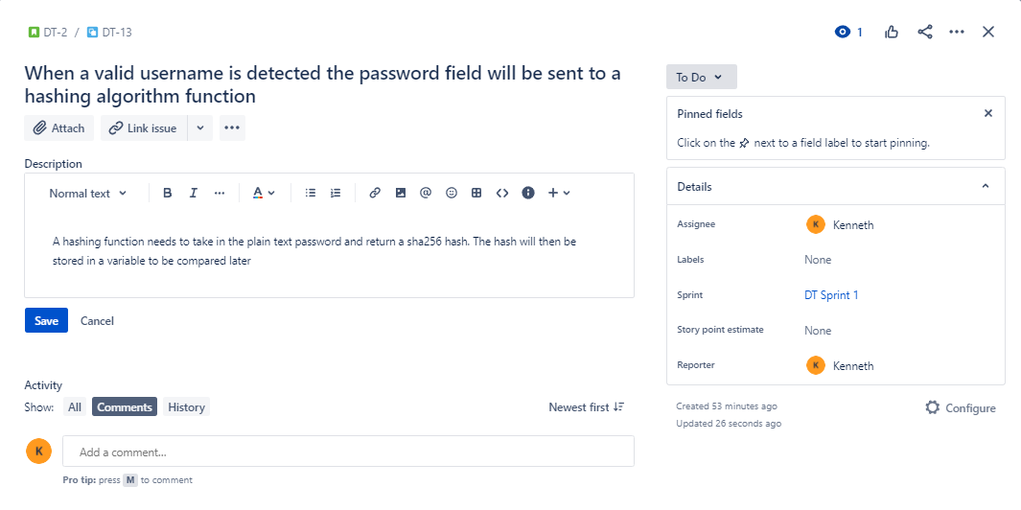
JIRA
Tasks
Should have a good description of what needs to be done the developer should not have to guess. Acceptance criteria should be in place so the developer knows what done is. Any input/outputs, functions or other items should be well documented.
Assign to a developer
Assign story points

Slide 21
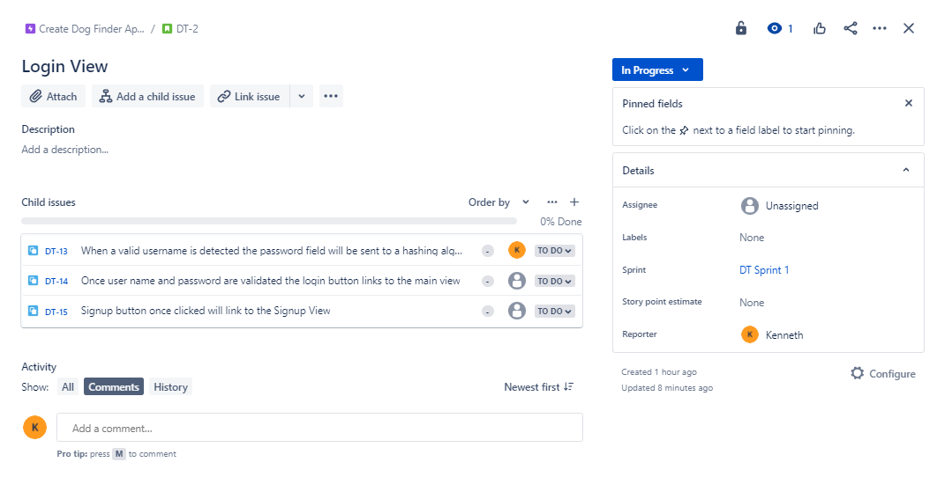
JIRA
The story tab within the sprint now shows assigned developers

Slide 22
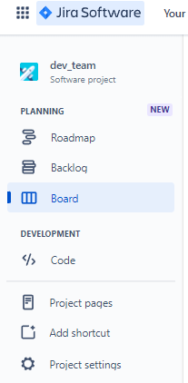
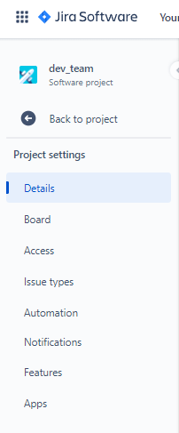
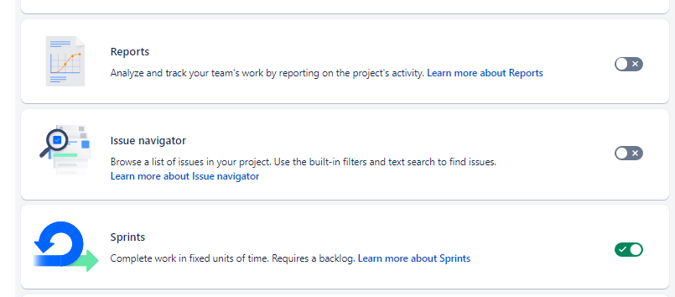
JIRA
Enable Burn Down Chart
Click project settings
Click Features
Enable reports

Slide 23
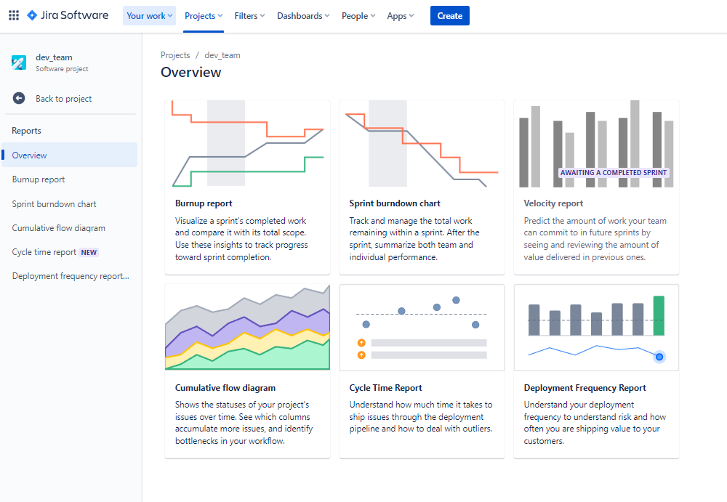
JIRA
With reports enabled a report tab will appear
When clicked the report tab will give you chart options
Click Sprint Burndown chart

Slide 24
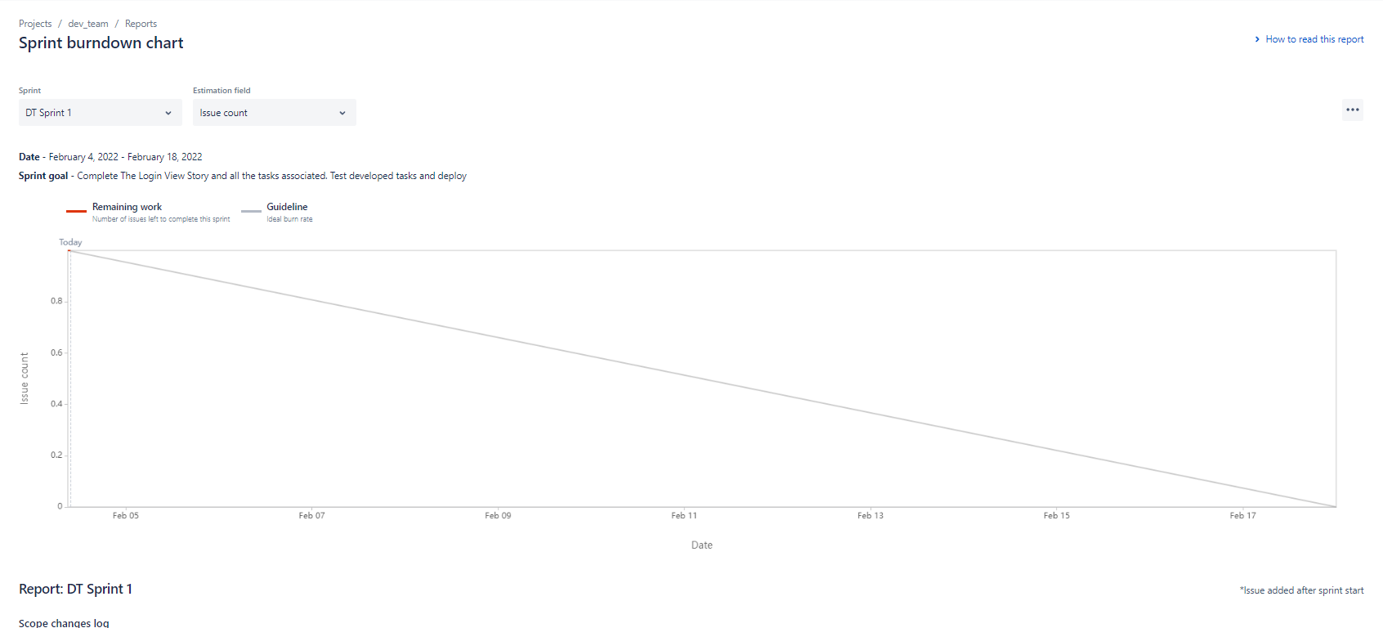
JIRA
Click the dropdown to view burn down based on stories completed
Red is the amount of story that has been completed against the rate needed to complete the sprint on time

Slide 25

Questions
Organize your JIRA this week
Next weeks lecture Git

